Slide 1
Hosting Web Application
-Snehal Deshmukh

Slide 2
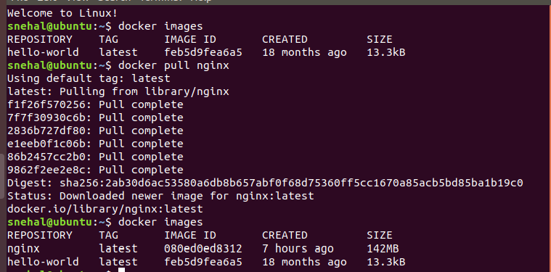
Pull a nginx docker image and host it's welcome page by running a docker container on port 8080

Slide 3
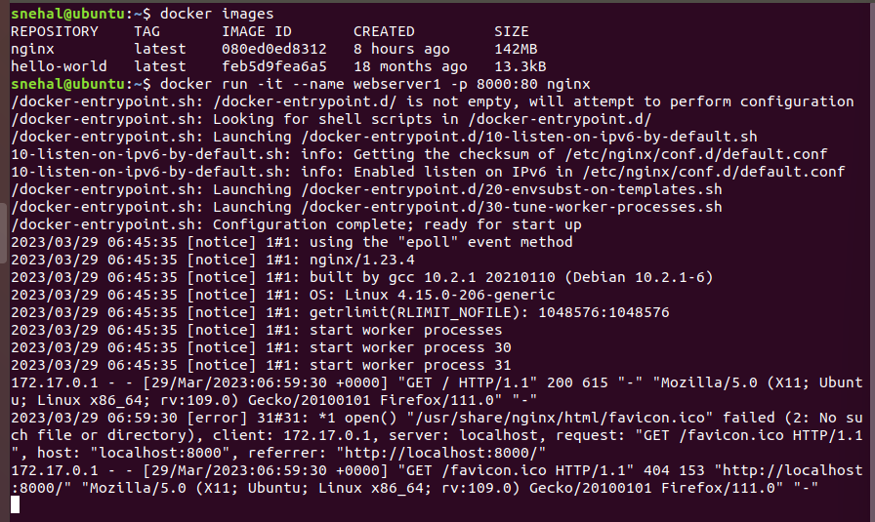

Slide 4
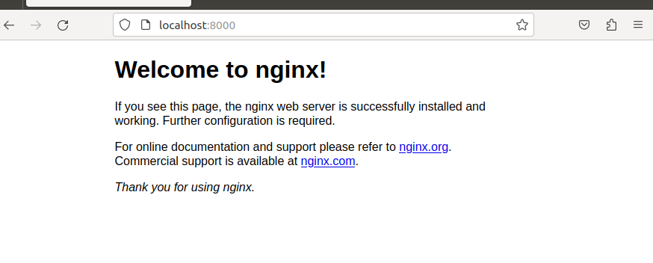

Slide 5
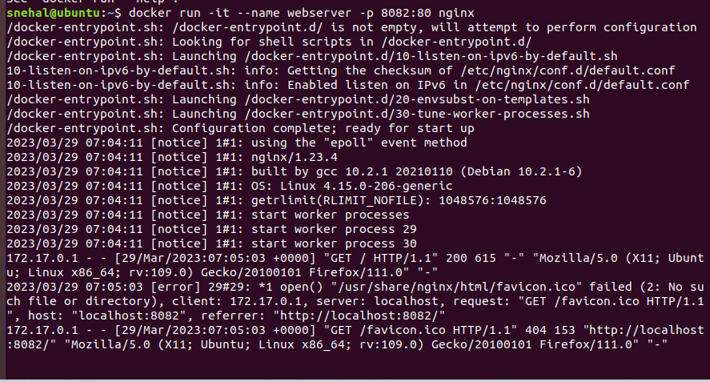
Pull a nginx docker image and host it's welcome page by running a docker container on port 8082

Slide 6
